Slide 1
Status of the Farm Bill
Joe L. Outlaw
Regents Fellow & Extension Economist
Co-Director, AFPC
Farm Foundation Forum
Washington D.C.
February 13, 2018

Slide 2
Presentation Outline
My Perspective
6th Farm Bill
Farm Level Work for the Committees
Need For a Farm Bill
The 4 Principals and Key Farm Bill Issues
Cotton and Dairy Fix
Other Issues That Could Impact Farm Bill
Farm Bill

Slide 3
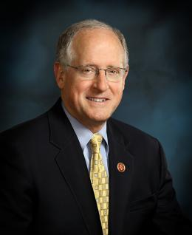
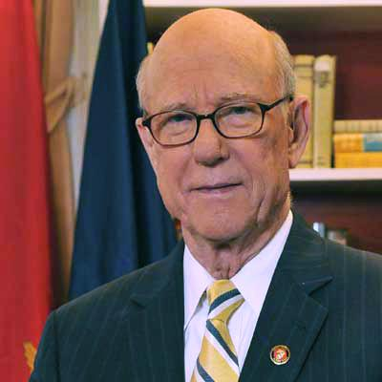
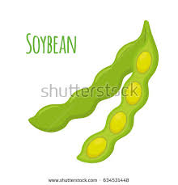
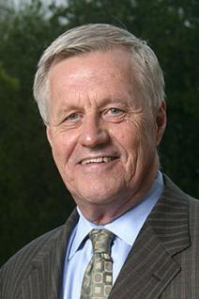
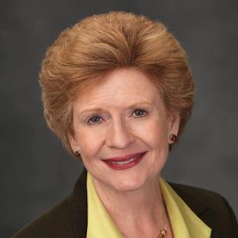

Slide 4
Issues that Could Impact Timing of and/or Derail the Farm Bill This Year
Immigration Reform
Welfare Reform
Infrastructure
Trade
NAFTA
China
TPP
Primary elections and November election
Congressional Calendar
Outside Groups

Slide 5
China soybean imports from U.S.
2016/17 data | mil. bu.
U.S. soybean exports to China | 1,332
U.S. soybean exports | 2,174
China imports as share of total U.S. soybean exports | 61%
U.S. soybean production | 4,296
China imports as share of total U.S. soybean production | 31%
Source: USDA FAS GATS database and WASDE, January 2018

Slide 6
2018 State Primary Election Dates
Texas is March 6th

Slide 7
