Slide 1
FDA Regulation of Animal
Biotechnology Products
Laura Epstein
Center for Veterinary Medicine
U.S. Food and Drug Administration
July 23, 2019

Slide 2

Legal Authority
FD&C Act: a drug = articles (other than food) intended to affect the structure or any function of the body of man or other animals...
Generally, must be approved

Slide 3


How Can an Animal be a Drug?
Answer:
The animal is not a drug
The regulated article is the intentional genomic alteration (IGA)
FDA does not approve the animal

Slide 4
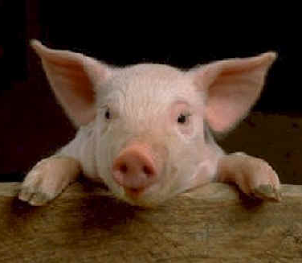
What This Really Means
FDA ensures it’s:
Safe to the animal
Safe to anyone that consumes food from the animal
Effective (does what it’s supposed to do)

Slide 5
EO on Modernizing Regulatory Framework for Agricultural Biotechnology Products
Section 4, Regulatory Streamlining
  Section 4(a): “within 180 days… identify relevant regulations and guidance documents… that can be streamlined…”
  Section 4(b): “use existing statutory authority, as appropriate, to exempt low-risk products of agricultural biotechnology from undue regulation”

Slide 6
Response to EO, Section 4: Guidance 187 on Regulation of IGAs in Animals
Draft revision issued in 2017
IGAs require premarket approval but enforcement discretion for low risk IGAs in animals
Explains how approval process works
Changes will clarify risk-based approach; eliminate confusing jargon; respond to commenters’ concerns
  FDA plans an outreach effort to engage stakeholders in a more technical revision of portion of guidance on the approval process; goal will be further streamlining

Slide 7
GFI 187: Risk-Based Approach
Enforcement Discretion with no prior data review
No data submission
Data to address relevant risk factors
Data commensurate with the risk profile of the product
Enforcement Discretion with prior data review
New Animal Drug Application (NADA) Approval

Slide 8
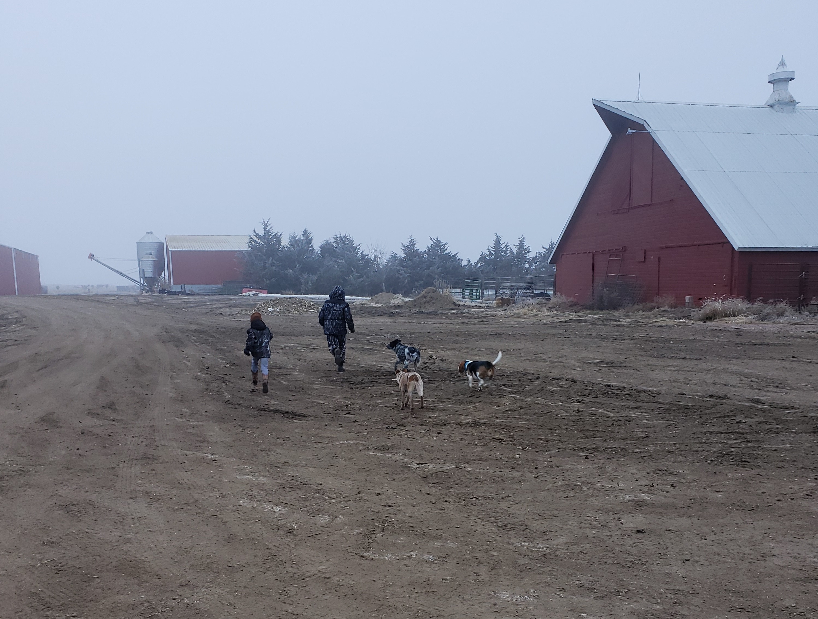
GFI 187: Clarification for Farms/Animal Producers
Farms that are just raising animals containing IGAs:
Are not drug manufacturing facilities
Do not have to register with FDA
Are not required to report adverse events to FDA (although they can voluntarily)
Do not need FDA approval to breed animals with IGAs with other animals

Slide 9
Response to EO, Section 4: Other Guidances
Guidance on IGAs in animals of food-producing species for use as models of human disease in research: Intend not to enforce approval requirement for a low-risk product
Guidance on establishing files of early information: will streamline regulation at early development stage by allowing use of a type of file that allows communication with FDA without incurring user fees

Slide 10

Response to EO, Section 4: Veterinary Innovation Program (VIP)
Available to IGAs in animals and ACTPs seeking approval that provide a benefit to health, food production, animal well-being
Furthers EO goals of timely and efficient application review and predictability and consistency of regulation
Currently 11 sponsors enrolled more expected to enroll shortly

Slide 11
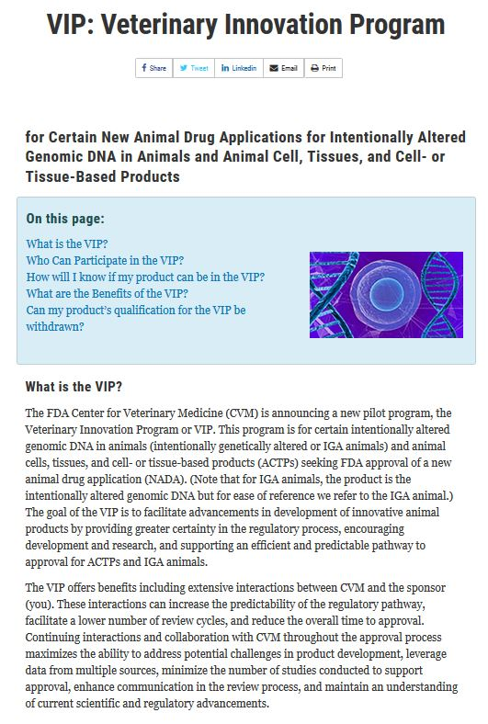
VIP, continued
Benefits:
VIP Toolkit
Frequent Interaction: meetings early and often
Dedicated Review Team
Alternative Data Discussions
CVM Senior Management Involvement
Feedback on Assay Development
Pre- and Post-Review Feedback
Stopping/Re-starting the clock
“How-to” help with Post approval requirements

Slide 12
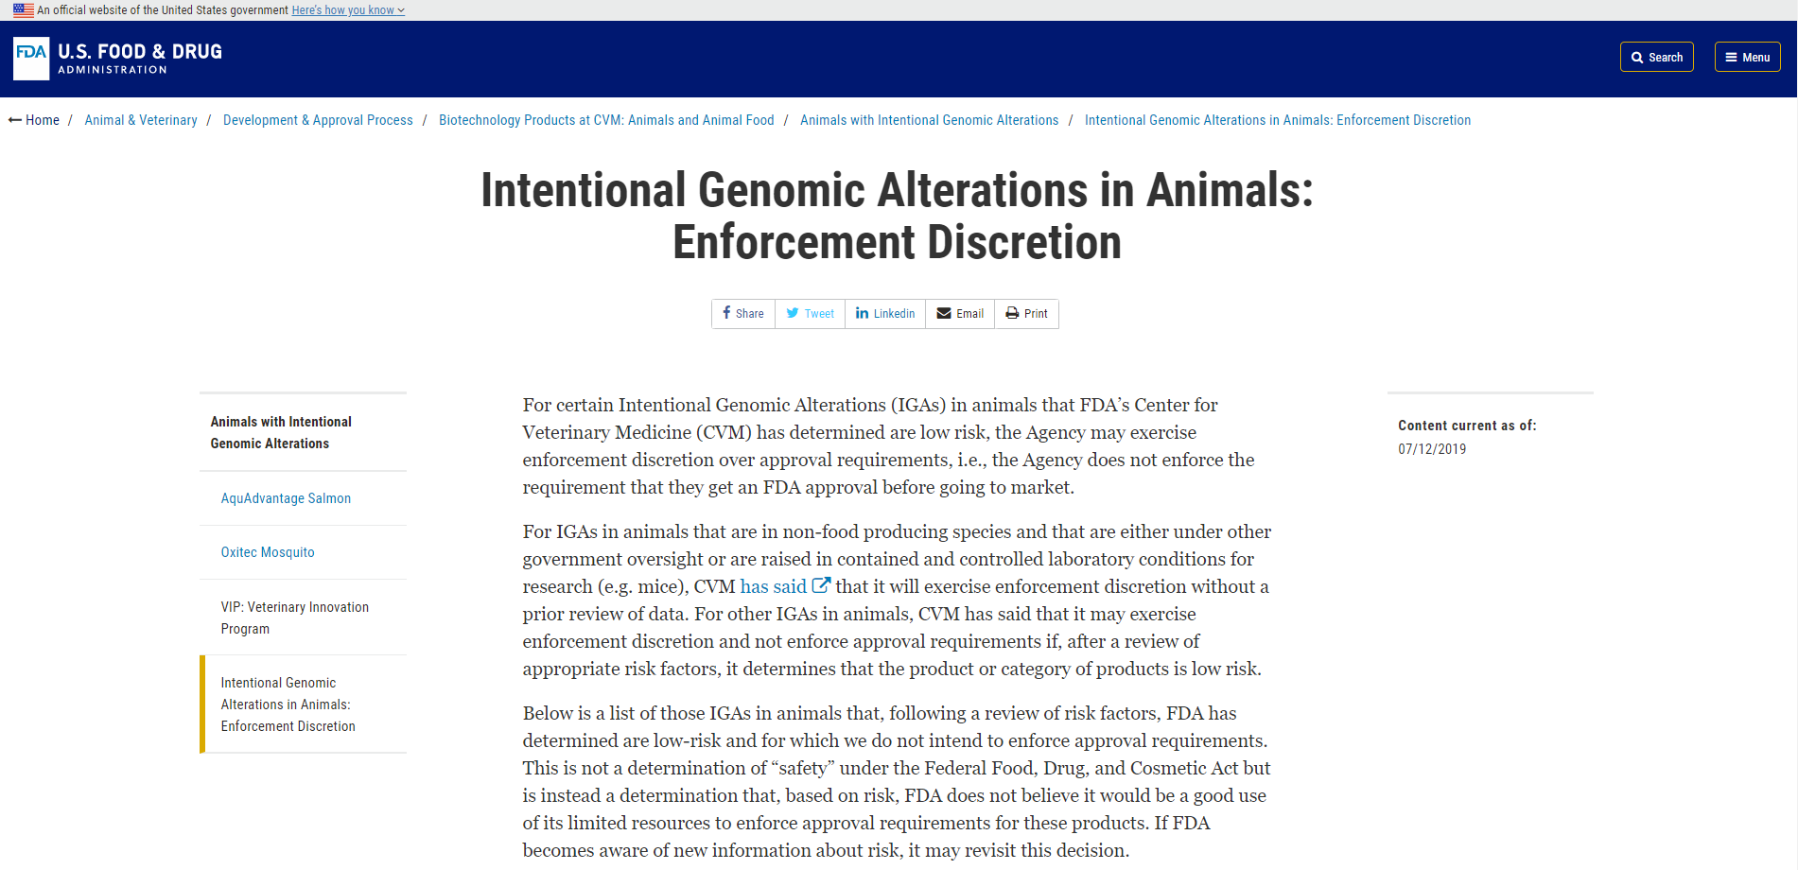
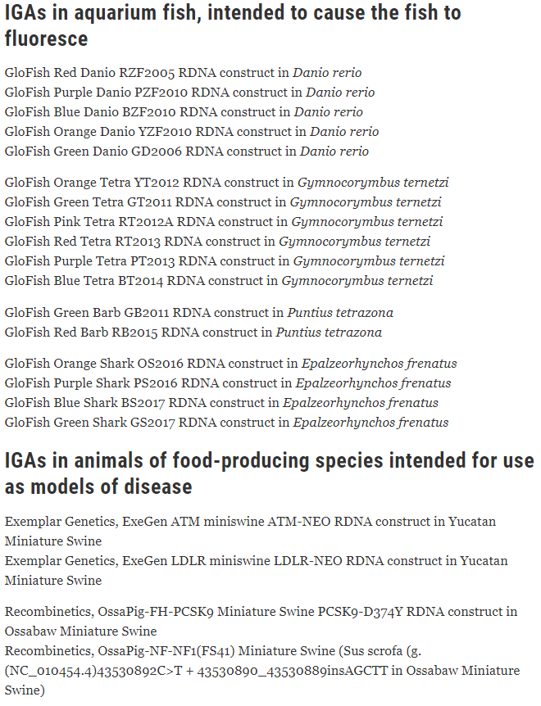
Response to EO Section 4: Transparency in Risk Determination
Following EO issuance, CVM created a web page that lists the IGAs in animals for which it has made a risk-based decision to exercise enforcement discretion rather than enforcing approval requirements

