Slide 1
Farm Family Wellness Alliance Webinar
May 2024

Slide 2
Webinar Agenda
Farm Family Wellness Alliance Overview, Shari Rogge-Fidler
Togetherall, Mary-Lyn Kieffer
Personal Assistance Services (PAS), Amie Merz
FFWA partners
  American Farm Bureau, Jessica Cabrera
  Farm Rescue, Terry Johnston
Conclusion
Please put your questions in the Q&A box and we will do our best to answer them throughout the webinar. Thank you!

Slide 3
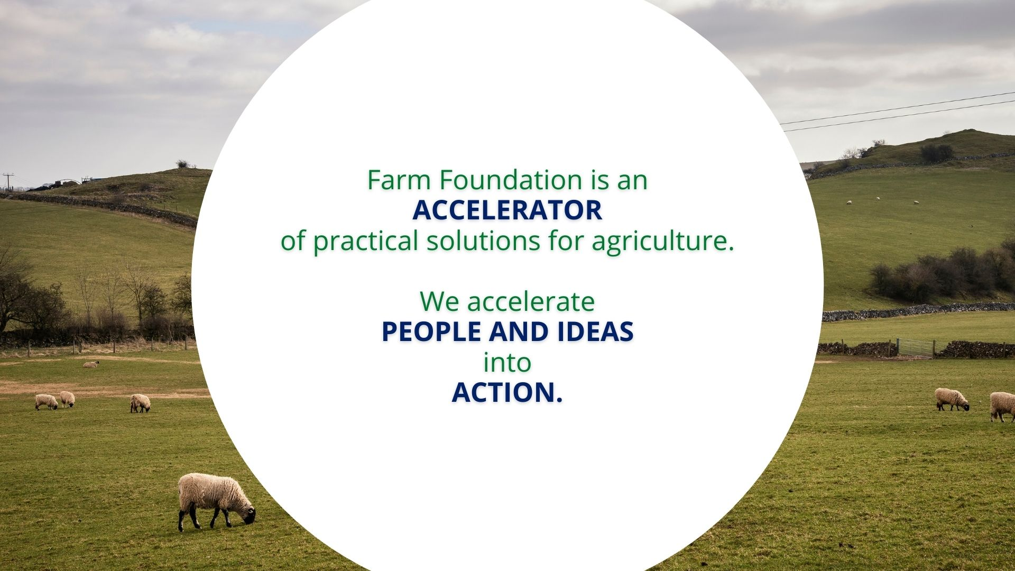

Slide 4
Our mission and vision guide our work
MISSION:
To build trust and understanding at the intersections of agriculture and society.
VISION:
To build a future for farmers, our communities and our world.

Slide 5
Strategic priorities for our work: accelerating People & ideas
Building a future for farmers, our communities and our world.
Building trust and understanding at the intersections of agriculture and society.
Building momentum with the new
Innovation and Education Center for local, regional and global in-person and virtual programs.

Slide 6
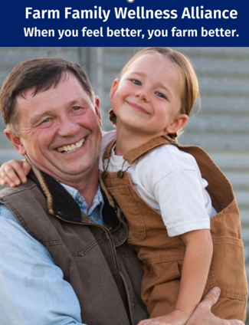
Why Farmer Mental Health?
Farmers and ranchers in the U.S. have demanding jobs that are often compounded by economic uncertainty, vulnerability to weather events, and isolation.
Rural agricultural communities may also have limited access to healthcare and mental health services, which can make it difficult for farm and ranch families to receive support when they are experiencing extreme stress, anxiety, depression, or another mental health crisis.
In recent years, the economic outlook for farmers and ranchers has been worsening, leading to comparisons to the Farm Crisis of the 1980s. Increasingly, agricultural families and communities are struggling, contributing to higher rates of suicide among farmers.
Farmer suicide rates are 2-5x higher than the national average.
Two in three farmers/farmworkers (66%) say the pandemic impacted their mental health.
Other issues like addiction, obesity, isolation, financial stress are leading to a crisis in rural/farmer/rancher family mental and physical health due to the lack of resources.

Slide 7

The Farm Family Wellness Alliance
Vision to provide a national service to all farm families, many of whom lack insurance or the local resources for farm family wellness.
Launched in late 2020 as pilot in a few counties in Iowa, then expanded to all of Iowa in 2021 with our partners at PAS (Personal Assistance Services, and national/local support from 4-H and Iowa Farm Bureau).
Supported with marketing via snail mail, social media, and some rural radio.
Expanded into Illinois in 2022.
We rolled out national Togetherall services in January 2024.
Sign ups have been steady and usage is good.

Slide 8













Farm Family Wellness Alliance Members
Gold Level
Marketing Partners
Silver Level
Bronze Level
Supporter Level

Slide 9

Join Farm Foundation in supporting farmers and farm families’ mental health and well-being!
Only available during Mental Health Awareness Month, 100% of proceeds of this limited-edition t-shirt will go towards the Farm Family Wellness Alliance, providing vital peer-to-peer mental health support for our farming communities nationwide.
In addition, all supporters will receive a one-year membership to the Friends of Farm Foundation program to stay in touch with the ongoing updates on this important service for our American farm families.
Get your shirt and make an impact today!
https://www.customink.com/fundraising/support-farmer-health

Slide 10

national suite of services
Farm Family Wellness Alliance provides, through partnership:
An online peer-to-peer community via Togetherall, monitored 24/7 by licensed clinicians
Wrap around suite of services provided by PAS (Personal Assistance Services) from resources to 1:1 counseling, including financial, nutrition, and mental health counseling.
Marketing, network engagement, and administration from Farm Foundation

