Slide 1
CULTIVATOR BREAKFAST
Round Table Meeting June 2024

Slide 2
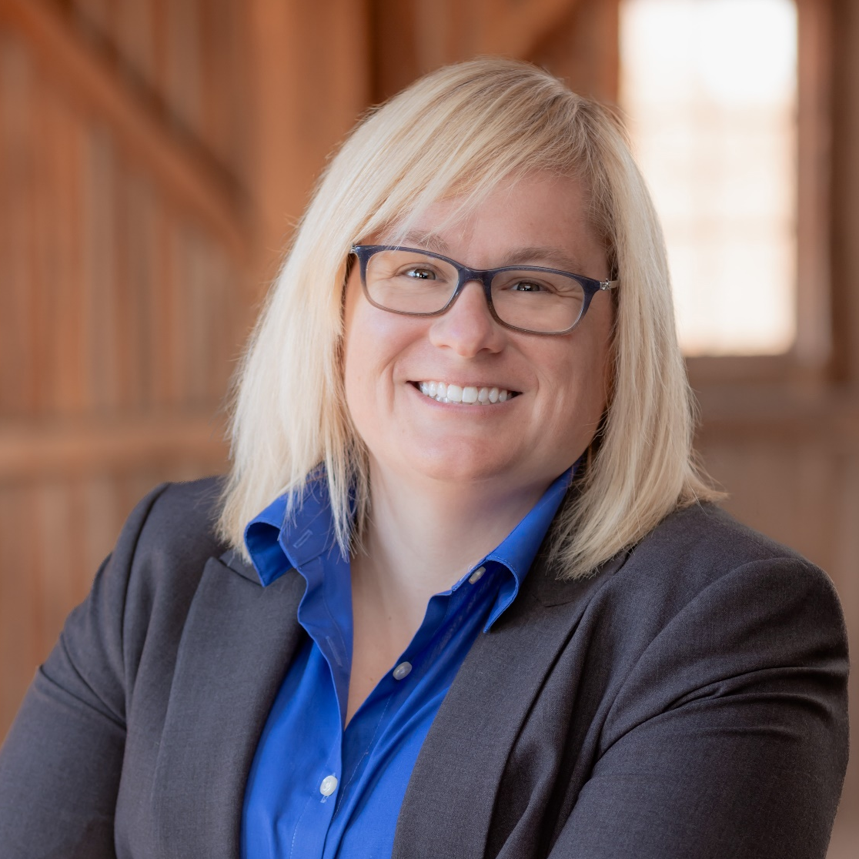
Moderator
Jenna Wicks
Program Manager Farm Foundation

Slide 3




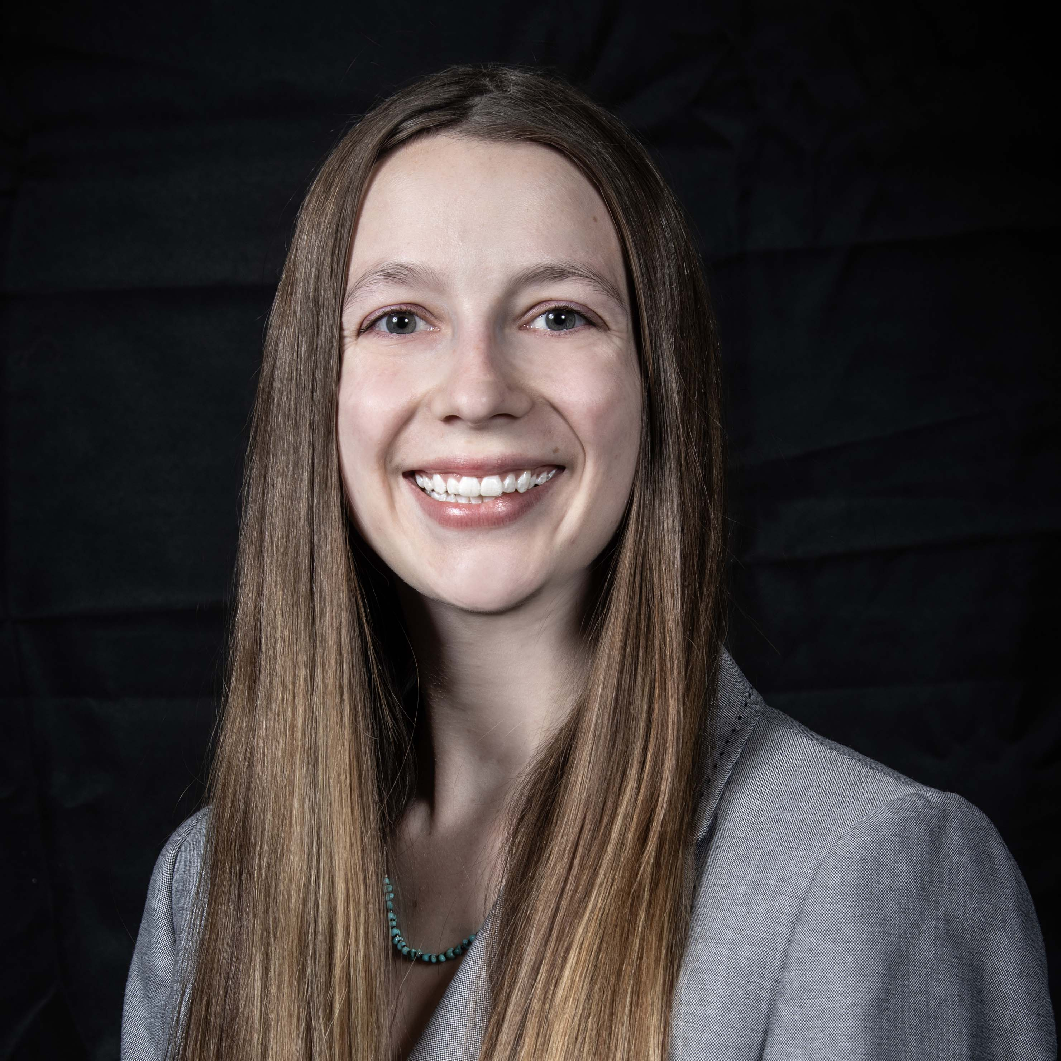

2024 JUNE CULTIVATORS
Kayla Grey
Southern Illinois
University Carbondale
Stephanie Gripp
Oklahoma State University
Brynn Johnson
University of Florida
Nafisa Lubna
University of
Nebraska-Lincoln
Kayla Scott
The Ohio State
University
Ivan Solomon
Tuskegee University

Slide 4
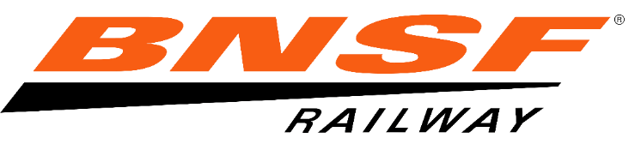
Thank you to BNSF and the
Round Table Fellows
for your support of the
Cultivators Program!

Slide 5
Kayla Grey
University of Southern Illinois - Carbondale

Slide 6

Horseradish Seed Production Among Various Illinois Accessions and Varieties
Kayla Grey
1st year Graduate Student
Dr. Alan Walters
Professor of Horticulture
Contact:
kayla.grey@siu.edu

Slide 7
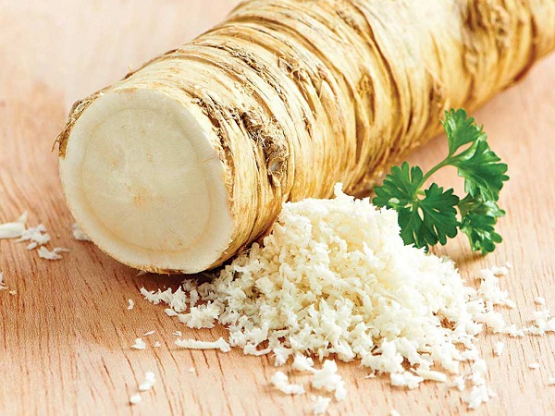
Notes:
Horseradish (Armoracia rusticana, Brassicaceae) is a hardy perennial specialty root crop that is commonly grown for its peppery, white, and plump root that is used globally as a condiment or spice.

Slide 8
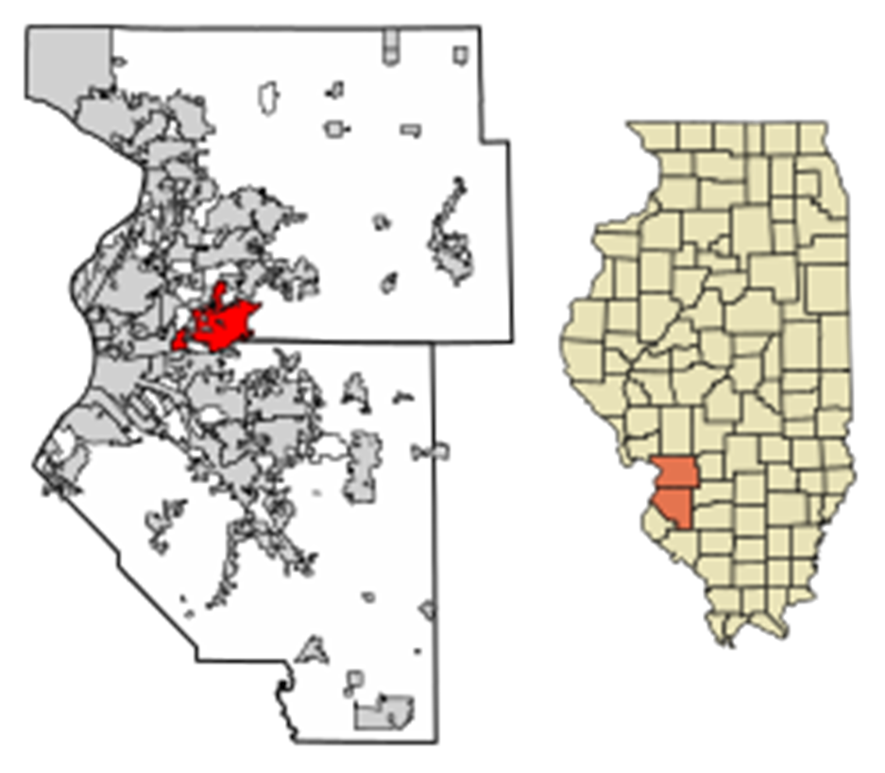
Horseradish in Illinois
Illinois leads the U.S. in production of this important specialty crop, with about 2500 acres having an annual farm-gate value of ~$25 million
Horseradish in Illinois is primarily grown in the Mississippi River Valley region adjacent to St. Louis
This region of southwestern Illinois has been producing horseradish commercially for over 150 years

Slide 9
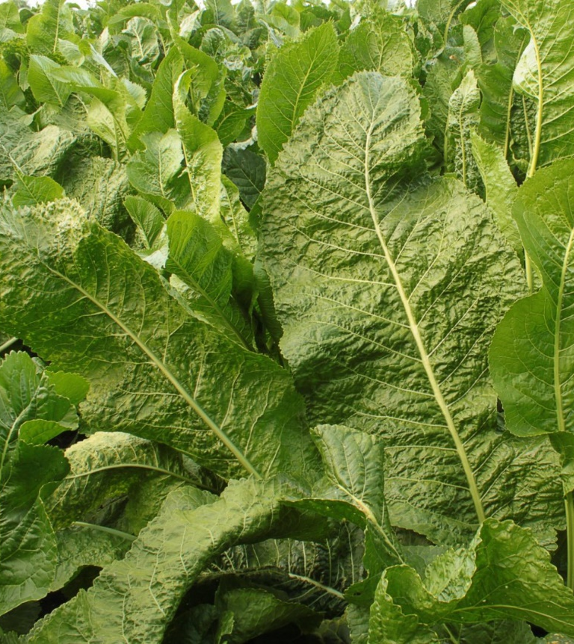
Horseradish Breeding at SIUC
Beginning in 2005, the SIUC Horseradish Breeding program has released over 40 new horseradish cultivars
Without these new cultivars the industry would not survive.

Slide 10
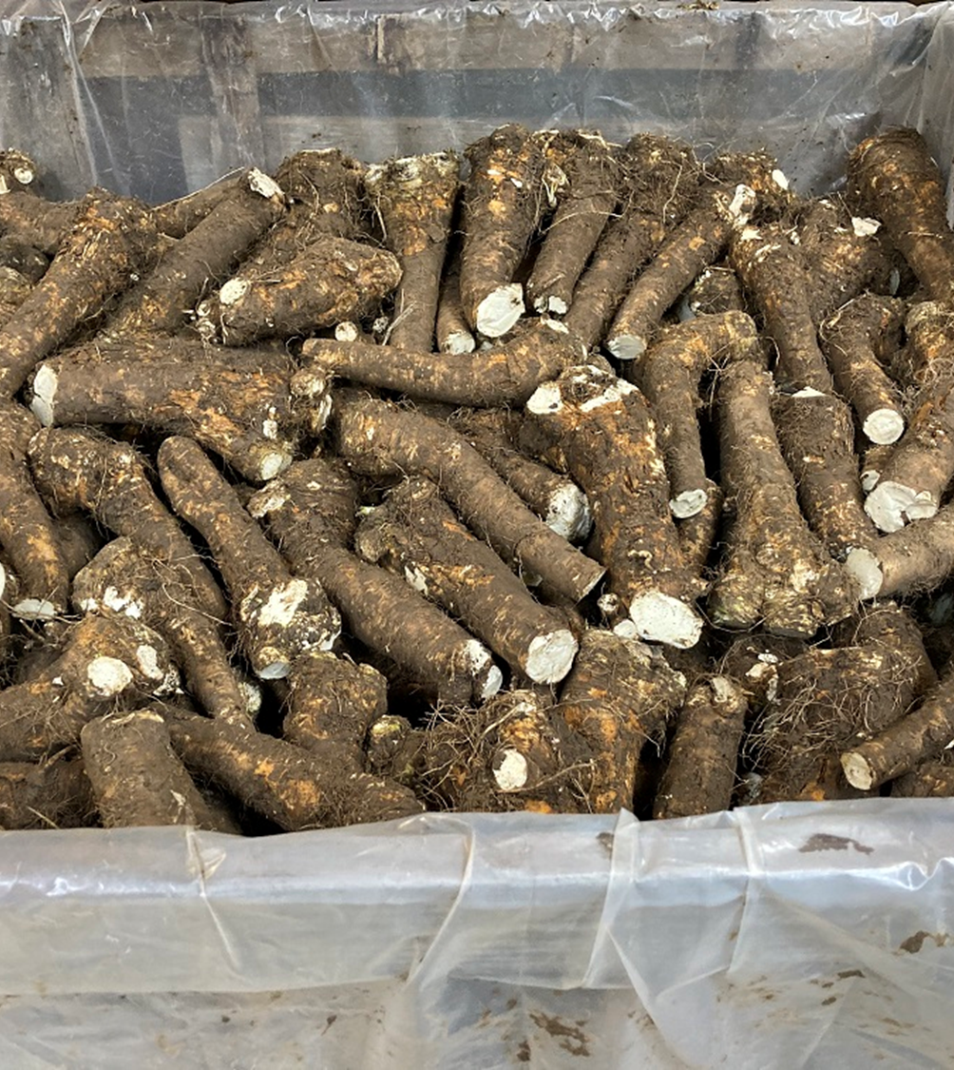
Goals of the Horseradish Breeding Program
To develop Horseradish varieties with increased Internal Root Discoloration complex resistance
High quality (smooth)
High yielding roots that produced high numbers of sets

Slide 11
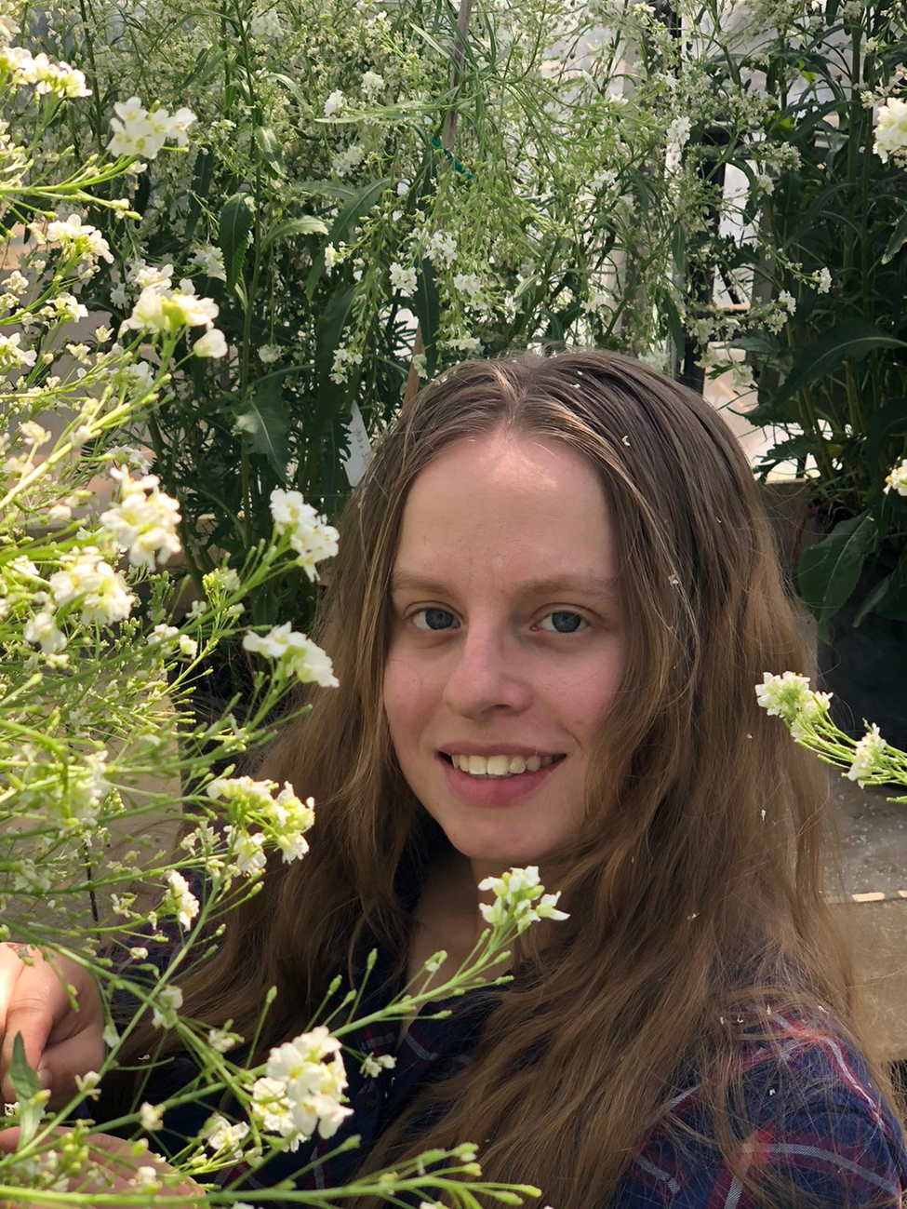
Thank You!

Slide 13
Stephanie Gripp
Oklahoma State University

Slide 14
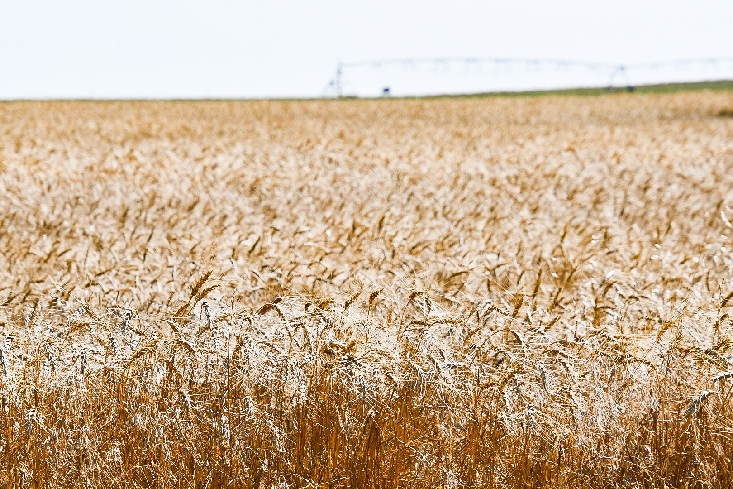
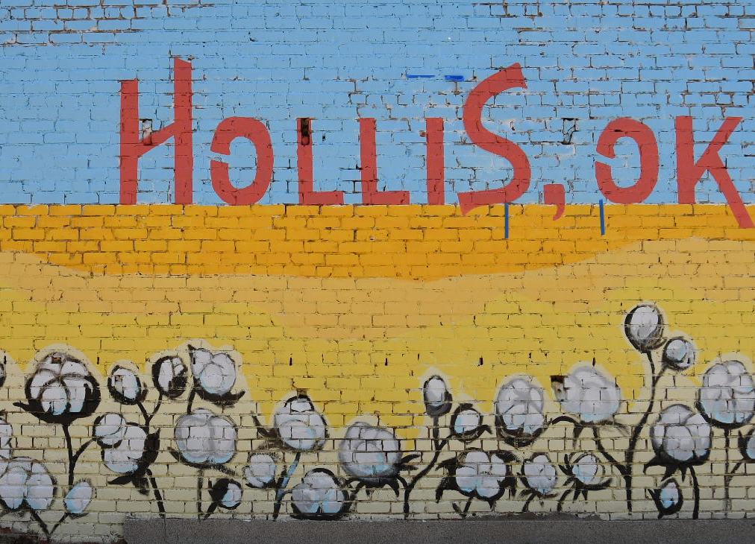
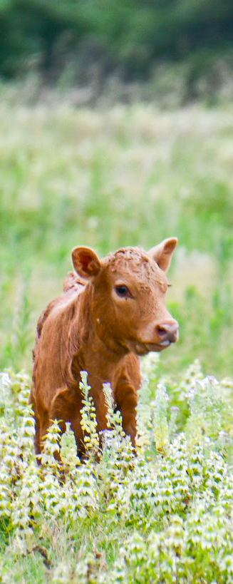
Political Capital in Rural SW Oklahoma
Political Capital in Rural SW Oklahoma
Political Capital in
Harmon Co., OK
Stephanie Gripp

Slide 15

Stephanie Gripp
Student at Oklahoma State University
M.S. in International Agriculture
  Focus on Rural Development & Entrepreneurship
2023 B.S. in Animal Science
  Minors in Law/Legal Studies & Agribusiness
2021 Rural Renewal Initiative Rural Scholar under Dr. Kristin Olofsson

Slide 16
How do rural community members view their political capital and relationships with political leaders?
■Do you feel that your interests are heard by local & state decision makers?
■Do you feel that there are opportunities for you to influence decisions or policymaking?
■Have you ever been involved in local or state policymaking?
■Who’s interests do you feel are represented in state politics?

Slide 17
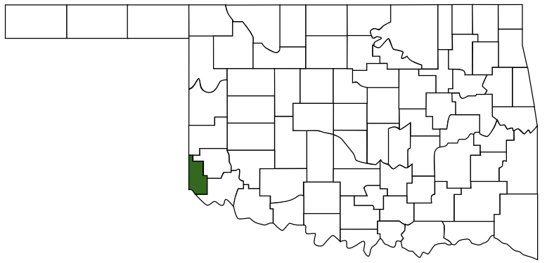
Interviews
20 interviews conducted
Harmon County, Oklahoma
  population 2,710
Demographics
  Residents of Harmon County
  Majority were middle aged
  Split between born and raised residents and residents who had lived elsewhere
  55% college graduates, 45% non-college graduates

Slide 18
Findings
At a local level, it tends to be the same people in charge of multiple organizations.
There are opportunities to be involved in local decision making; however, there are mixed feelings about how easy it is to become involved.
While state representatives do visit the area, people feel like the community’s voice is lost after the fact.

Slide 19
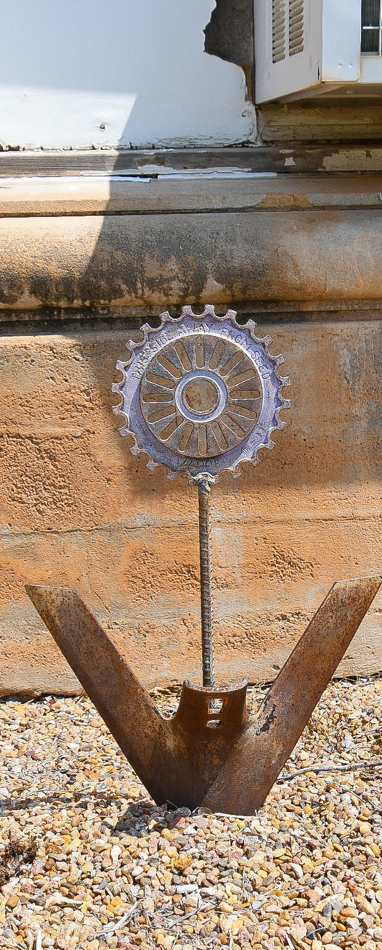

THANK YOU!

Slide 21
Brynn Johnson
University of Florida

Slide 22
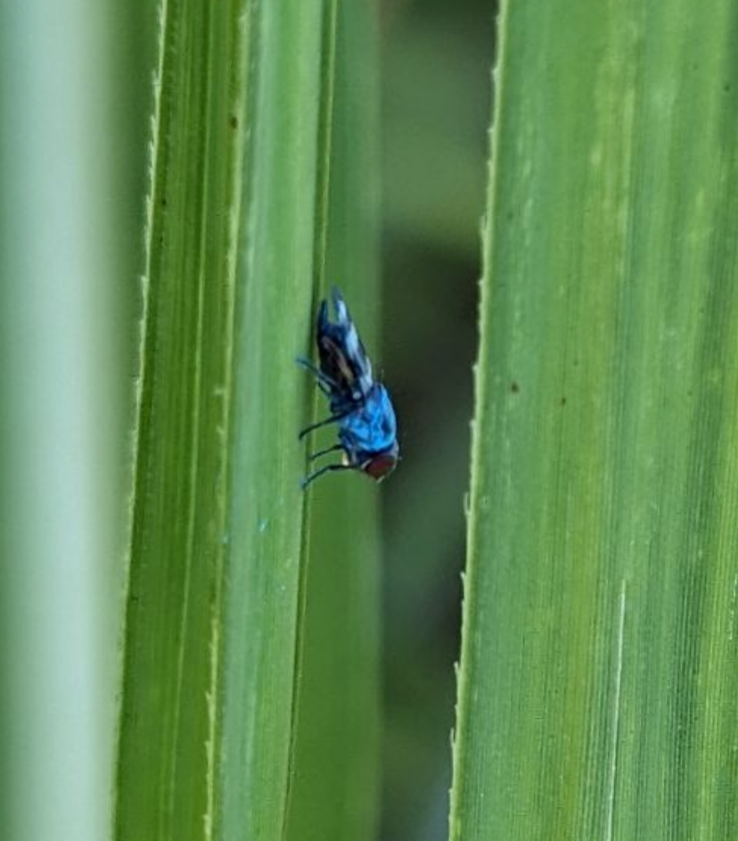

Targeted Corn Silk Fly Control
Marking Evaluation, Movement Analysis, Behavioral Manipulation, and Biological Control Potential
Presenter: Brynn Johnson
Chair: Julien Beuzelin
University of Florida
Everglades Research and Education Center

Slide 23
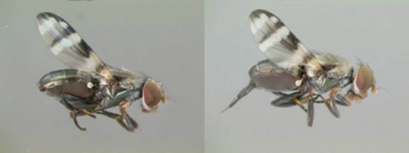
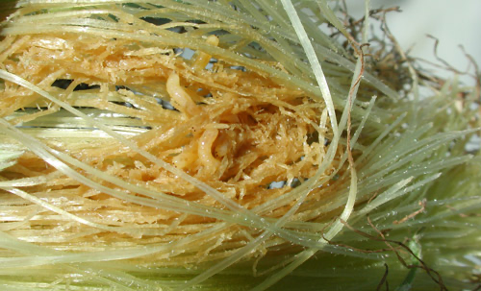
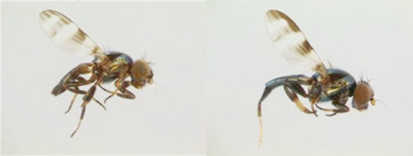
CORN SILK FLIES AS PESTS
Euxesta eluta
Euxesta stigmatias
Economic value in Florida > $200 million (USDA, 2024)​
Corn silk flies damage silks and kernels by feeding as maggots
Management includes frequent insecticide applications, but management failures still occur
Notes:
Mention that 2022 was an anomaly if asked– normally things would hover closer to 35-45,000 acres and value closer to 150 million

Slide 24
Research Objectives
Identify marking method for corn silk fly
Utilize marking method in mark release recapture study to evaluate corn silk fly movement
Manipulate corn silk flies away from sweet corn using attractants and repellents
Control corn silk fly populations in sweet corn fields using entomopathogenic nematodes

Slide 26
Nafisa Lubna
University of Nebraska - Lincoln

Slide 28
Kayla Scott
The Ohio State University

Slide 29
Investigating the effects of sheep sex (ram vs wether) on productivity and carcass characteristics and their potential for vegetation management on solar farms
Kayla Scott, MS Student
Advisor: Dr. Brady Campbell

Slide 30

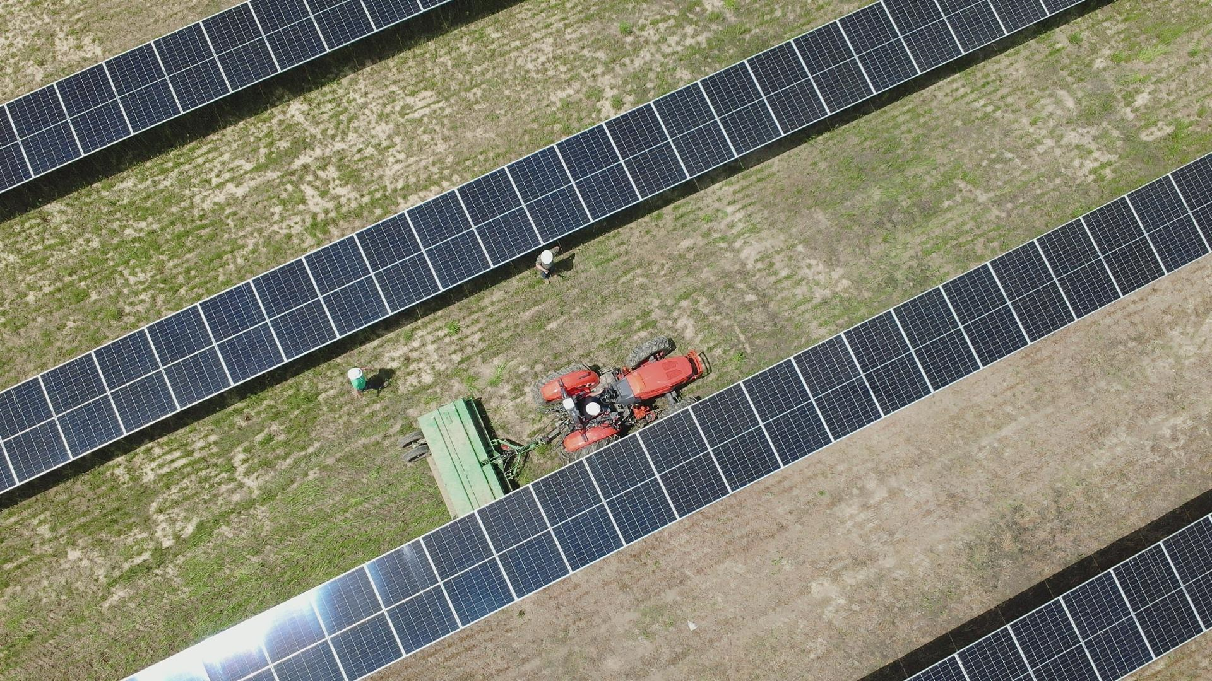



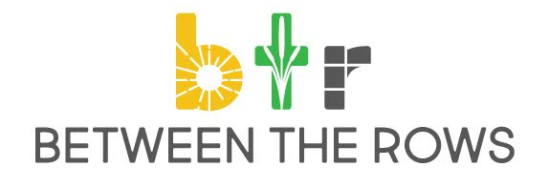
Introduction
Feeding a growing population
Increased need for protein sources
  Efficiency (lamb growth and feed efficiency)
Niche Marketing
Sustainability
Interest in renewable energy
Photovoltaic energy production (Solar)
Operating costs
  Vegetation management
Madison Fields Solar Project
Benefits for producers and consumers
Putting farming back into farmers hands
Sustainable agriculture

Slide 31
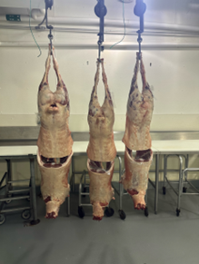
Productivity and Carcass Characteristics
Rams
Wethers
Utilize feed more efficiently
Heavier live and hot carcass weights
Larger ribeye sizes and lower yield grades
Greater dressing percentages
Easier pelt removal – why?
Sensory and quality differences?

Slide 32

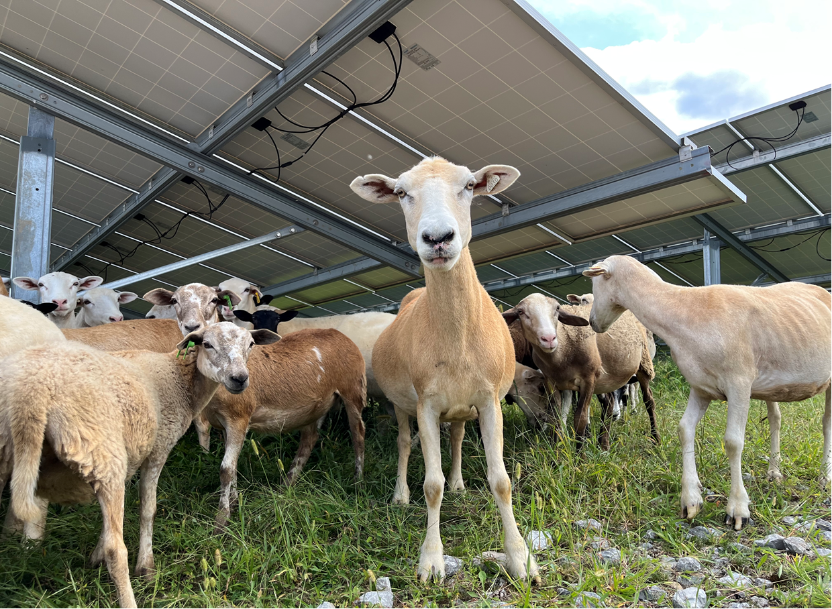
Bridging the Rural-Urban Divide
Image Source: World Atlas

Slide 33
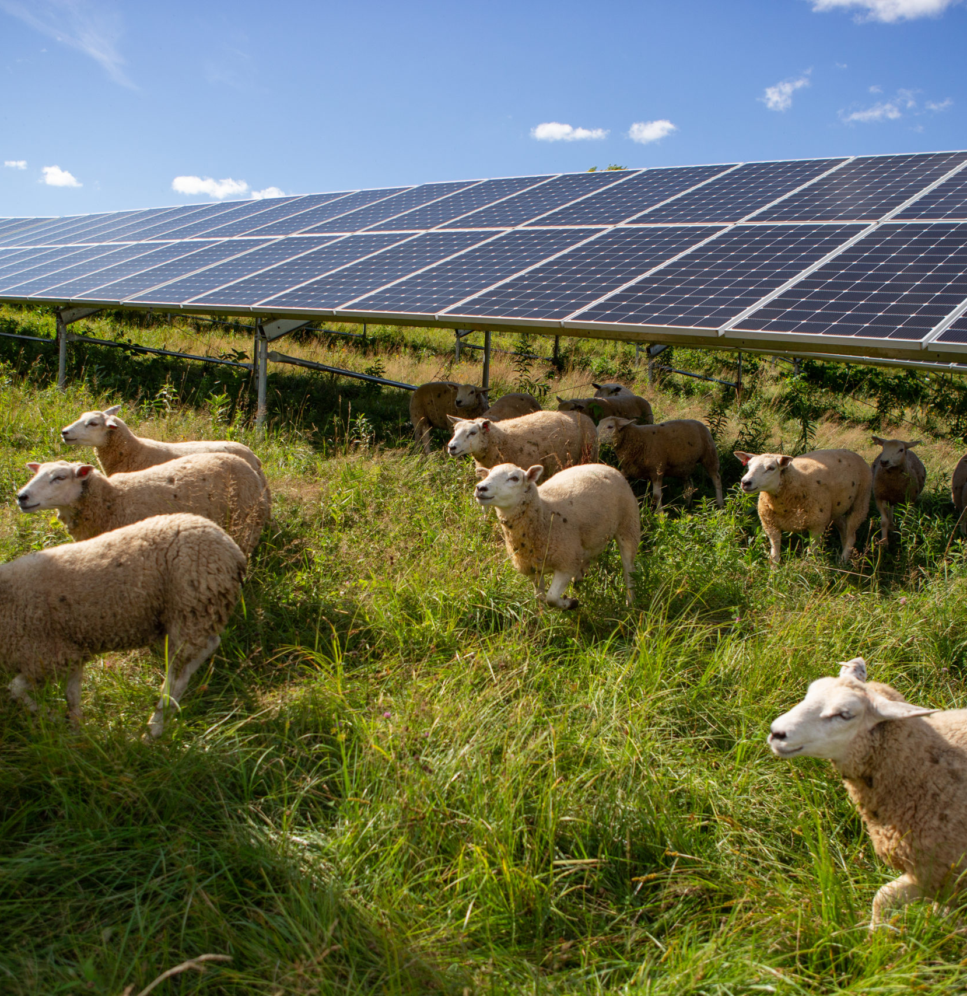
Vegetation Management for Solar Farms
Why sheep?
Benefits of dual use land
Economics of photovoltaics in agriculture
Image Source: American Solar Grazing Association
Notes:
American Solar Grazing Assoc.-pics

Slide 35
Ivan Solomon
Tuskegee University

Slide 36





Rewarding Bad Actors? Trade Volumes and Human Rights Under AGOA
Ivan Solomon
Tuskegee University

Slide 37



The African Growth and Opportunity Act
  Passed in 2000
  Expanded upon GSP
    6,700 goods total
  Unilateral agreement

Slide 38



Who Qualifies
Democratization
Economic liberalization
(B) the rule of law, political pluralism, and equal protection under the law;
(E) a system to combat corruption and bribery;
(F) protection of internationally recognized worker rights, including the right of association, the right to organize and bargain collectively, a minimum age for the employment of children, and acceptable conditions of work with respect to minimum wages, hours of work, and occupational safety and health.
A) a market-based economy that protects property rights and minimizes government interference in the economy;
(C) the elimination of barriers to U.S. trade and investment;
(D) economic policies to reduce poverty, increase the availability of healthcare and educational opportunities

Slide 39
Trends
Imports
Metrics

Slide 40


Results
Fixed effects for AGOA metrics
 | lnTVIM | lnPVIM
Economic freedom | - | +
Civil liberties | N/E | +
Political rights | - | -
Worker rights | N/E | N/E
  Negative impact of economic freedom on TVIM, positive for PVIM
  Political rights show a significant inverse relationship
  Civil liberties significant positive relationship

Slide 41

Conclusion
Evaluation
Implications
Opaque approval process
Limited leverage
Rewarding bad actors
Act is due for renewal in 2025
Power of U.S. trade incentives

